Slide 1
Intra-household allocation
Econ 591
Rachel Heath

Slide 2
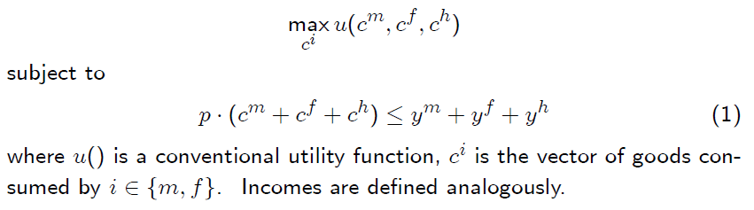
Starting point: the unitary household model
Becker (1973): “two agents become one”

Slide 3

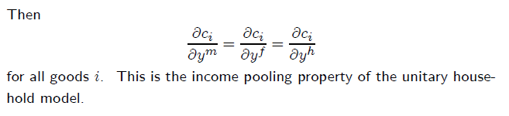
Testable implications of the unitary household model
Early tests of this in Ted Bergstrom, 1997, “A Survey of Theories of the Family” in Stark and Rosenzweig, eds., Handbook of Population and Family Economics
Notes:
Who gets the income doesn’t matter for how it’s consumed

Slide 4
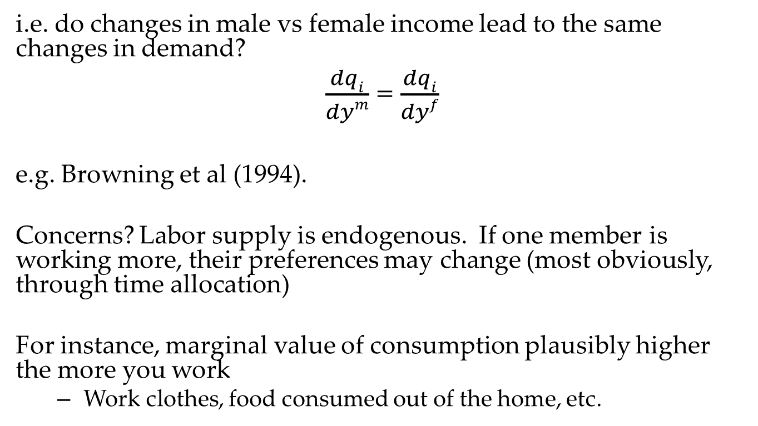
Test unitary model by testing income pooling
i.e. do changes in male vs female income lead to the same changes in demand?
$\frac{dqi}{dym}$ = $\frac{dqi}{dyf}$
e.g. Browning et al (1994).
Concerns? Labor supply is endogenous. If one member is working more, their preferences may change (most obviously, through time allocation)
For instance, marginal value of consumption plausibly higher the more you work
Work clothes, food consumed out of the home, etc.

Slide 5

Is un-earned income better?
$\frac{dqi}{dymn}$ = $\frac{dqi}{dyfn}$
Thomas (1991) and Schultz (1991):
Argument: non-labor income falls (exogenously) out of the sky
Less likely to be related to preferences
Remaining problems
Non-labor income is often “congealed” labor income, e.g. pensions, inheritances from parents
Reflect their (and your?) occupation
Still correlated with preferences?
Selection: do women with lots of wealth marry men with different preferences?

Slide 6
Duflo “Grandmothers and Granddaughters”
Idea: use a permanent change in non-labor income to test for income pooling.
South Africa Old Age Program
In early 1990s old age pensions - which were small for white population - extended to entire country.
Huge transfer for poorer Africans
Twice per-capita income
Pensioner often largest earner in household
Key question: Does the identity of recipient affect child health?

Slide 7
Methodology
Eligibility: age 65 for men, 60 for women
Look for a discontinuity in anthropometrics of kids in eligible households
Use different anthropometrics to judge short run vs long-run nutritional status
Height: long run
Weight for height (e.g. BMI): short run
Weight: both
Why is anthropometrics often a better measure of health than having reported a recent illness?
Standards for considering something an illness subjective
Worse if nonrandom, may reflect time use decisions or SES (Das et al 2013)
Development economists growingly using other objective measures (grip strength – Pitt, Rosenzweig and Hassan; hemoglobin – Duncan Thomas and coauthors)
If you want to use such measures in your research, CSDE has (free!) biodemography consulting

Slide 8
Review of regression discontinuity
Treatment assigned if some variable X is above a threshold X
T_{i} = 1(X_{i} ≥ X)
Other examples: Grameen Bank 0.5 hectare rule, national roll out of Progresa based on poverty index of district, admissions tests, birthdays
Compute effects of treatment by looking at people just above and below cutoff
E(Y|X + ε ≥ X ≥ X) - E(Y|X > X ≥ X - ε)
Empirical implementation
Y = β*1(X_{i} ≥ X) + g(X) + ε
Empirical considerations
g(x) should be flexible (but not too flexible – Angrist and Gelman 2015), but even then…
need lots of data around X (otherwise identification coming from the functional form assumptions on g(x))
Did the discontinuity exist in practice? (Grameen bank case: Morduch (1998) argues not)
Strategic sorting?
Notes:
Angrist and Gelman – leads to overfitting, you just match random noise

Slide 9
Grameen bank “discontinuity”
Helpful formal econometric test of discontinuity from McCrary (2008)

Slide 10

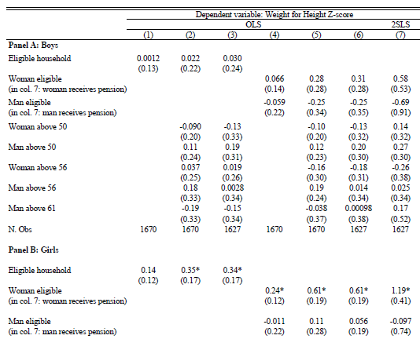
Back to Duflo: main specification
Notes:
Weight for height z score as a function of male and female eligibility, conditional on the running variable (age of grandparents)

Slide 11
A further check using within family variation
What if household structure is correlated with pension availability?
E.g. families re-arrange after pension eligibility
And children have different growth paths in these families
If so, there would be selection at the discontinuity
Use height as an accumulated stock
The more you’re exposed to better nutrition, the taller you’ll be
Allows within-family comparison (family FE’s)
Look at younger vs older kids in pension families, compared to the difference in non-pension families: are younger kids doing particularly well in pension families?
Then identification only problematic if rearrangement occurs in response to siblings who would be particularly responsive
Note that this is a substitute for pre-program data
If you had it, though, could do a triple-difference: pre versus post, eligible versus not, younger versus older

Slide 12
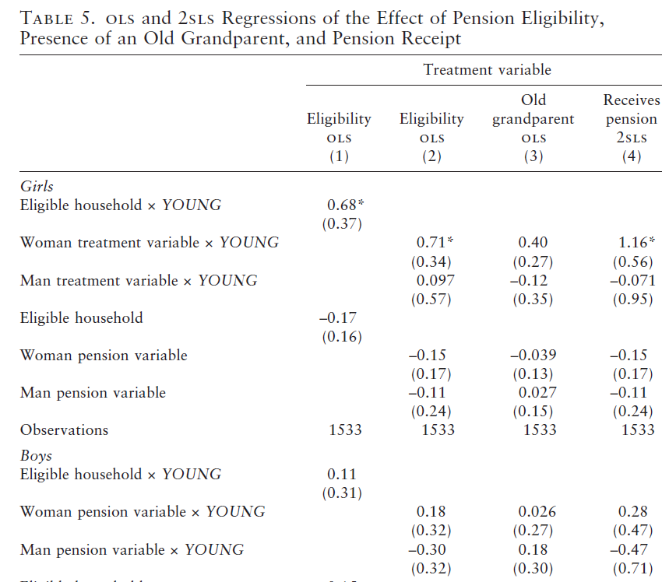
Insignificant main effect provides evidence against selection into program
Notes:
Again, effect driven by Woman treated X Young, in girls panel
10-6-2015: I looked a long time at the table in paper and think that “treatment” in the girls panel the same as “pension” in the boys panel

Slide 13
Missing girls and their mother’s earning potential
Earlier in class: I argued that it’s hard to get exogenous variation y_{m}, y_{f}
Hence Duflo’s rationale for looking at universally given government pension
But since earned income may affect bargaining power differently than unearned, would love to find a nice natural experiment
Qian (2008): Post-Mao reforms in China dramatically improved the price of cash crops (orchards and tea)

Slide 14
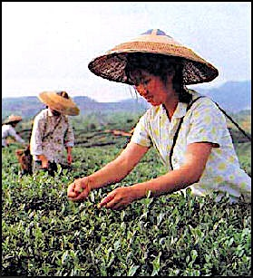
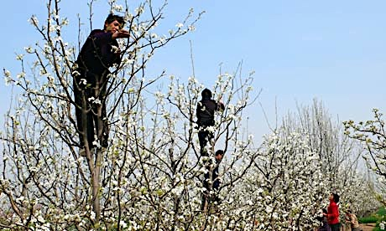
Tea, orchards, and comparative advantage by gender
Tea picking favors fine motor skills
Orchards favor height and strength
What if more female friendly areas began planting tea after reform? (note that only a concern if selection varies by pre vs post). Instrument for tea production with hilliness

Slide 15
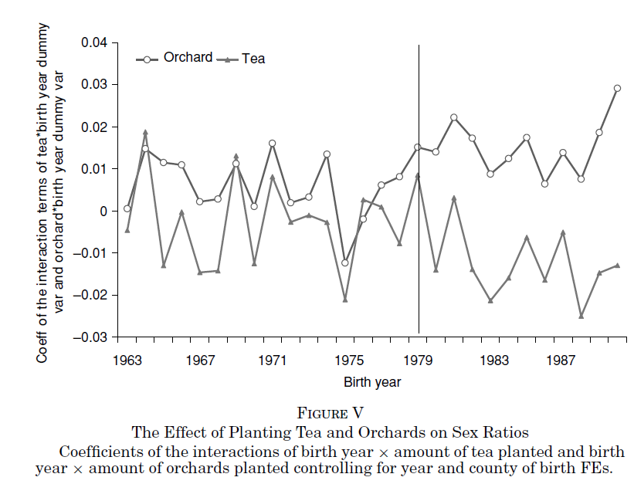
Notes:
Sex ratio traditionally defined as more men

Slide 16
Is this inconsistent with the unitary household model?

Slide 17
Unitary household
Sex ratio result consistent with unitary household that makes human capital investment based on expected returns
Additional education result
Increasing women’s income → increased educational attainment for girls and boys
Increasing men’s income → decreased educational attainment for girls, no effect on boys
“not consistent with the unitary model unless the returns to education for girls are negatively correlated with male income and the returns to education for boys and girls are positively correlate with female income”

Slide 18
More evidence for women’s earned income → bargaining power
Atkin (2009) looks at women induced to work in factories in Mexico
By a factory opening in her town when she reached the legal employment age of 16
These women have taller children (1 standard deviation – big effect!)
The survey data he uses has self-reported bargaining power. It went up too.
Majlesi (2016) shows that bargaining power up when job opportunities arise, even among women who do not take the job
Still improves their outside option

Slide 19
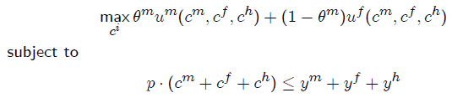
Collective household model
Browning and Chiappori (Econometrica, 1998)
More general assumption that household allocation is Pareto-efficient
i.e., no resources are wasted
Notes:
Since hh’s aren’t unitary, what model should we use? Relax unitary model but maintain efficiency. So the hh solution corresponds to a planner’s problem.

Slide 20
Efficient allocation within the household
θ^{m} gives weight on male’s utility relative to female’s utility
Where does θ^{m} come from? Bargaining theories tells us it depends on each member’s outside option/threat point.
Divorce?
Informal separation? (if divorce prohibitively costly)
Noncooperative behavior within marriage (Lundberg and Pollak “separate spheres” model, 1993)
Probably it also depends on things that standard economic theory doesn’t have that much to say about (culture, etc.)
“We’re economists, not marriage counselors” -- Udry

Slide 21
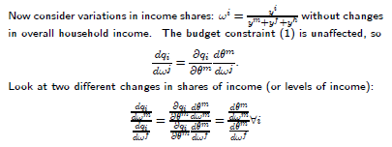
Variations in income shares
All the changes are working through the one-dimensional function θ^{m}(w^{f}, w^{m},p,y)
The ratio of consumption changes should be the same for all goods
Changes in bargaining power affect which Pareto efficient bundle is consumed, but not the set of Pareto efficient bundles
Under the unitary household model, this ratio should be 1
Change in consumption all through change in Pareto weight
Notes:
How does consumption of a good change when income shifted from one spouse to another? It all comes through the Pareto weight. So we can test this with data on shifts in shares of income/Pareto weights and individual-specific consumption.

Slide 22
Gender, children and intrahousehold distribution: missing women
Amartya Sen - about 100 million women “missing” (1990)
Women who were either not born (selective abortion) or were born but died more rapidly relative to men than would be expected ‘in absence of discrimination’
Current estimate 160 million, mostly due to increased availability of ultrasound
# of missing =
total pop * nondiscriminatory gender ratio, then subtract number of women
(non discriminatory gender ratio: use North America/Europe or Sub-Saharan Africa. Typically 1.022)
Notes:
One clear consequence of large variations in bargaining weights

Slide 23
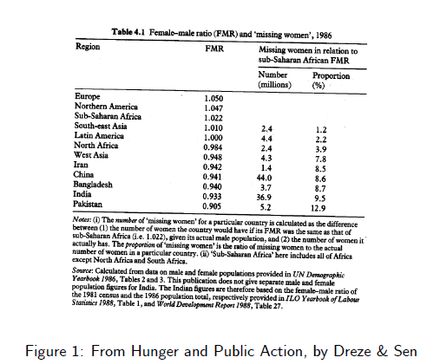

Slide 24
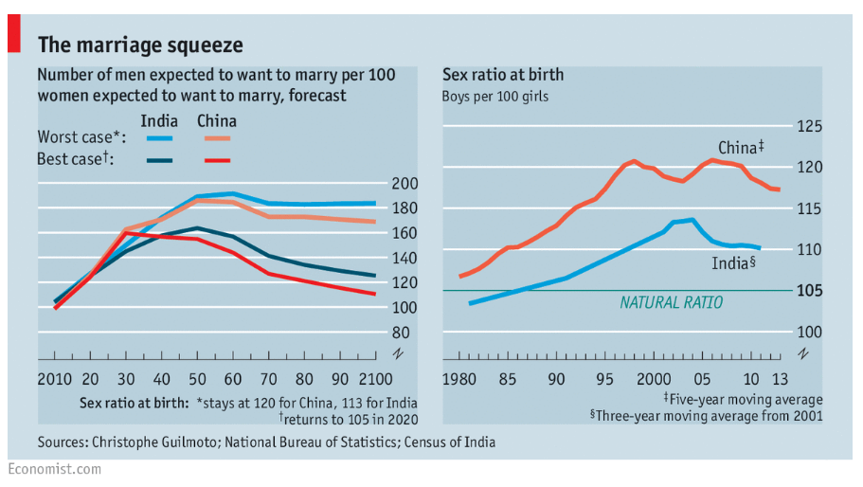
Worse today
Linked to social problems like higher crime (Edlund et al 2013)

Slide 25
Are all missing women due to discrimination?
Biological factors?
Hypothesis that mothers with hepatitis more likely to have girls
Now largely disproven... It turns out that sex ratios at birth only skewed for later births, not first births
Girls live in larger families, so may have worse outcomes even if treated the same within a family

Slide 26
When does discrimination appear?
From Sen’s book….
Infanticide? No evidence from Punjab. Mortality from birth to 1 month (per 1000):
Male 51
Female 43
Male/female mortality ratio at other ages
1-11 months: 0.53
12-23 months: 0.51
24-59 months: 0.65
So we’re starting to see the gap appear. Maternal mortality causes another jump.
Of course, now sex selective abortion is now important in some areas (Bhalhotra and Cochrane 2010; the economist chart we just saw)
But it can’t be the only cause of missing women. We see missing women ever where sex ratios at birth are close to the natural level.

Slide 27
Is excess female mortality of young children due to discrimination?
We want to test whether parents are spending more on boys than girls.
Original idea: look for expenditure on children (male vs female) directly. Difficult data to collect (conceptually and practically)
Deaton (1989): if parents spend more on boys than girls, we should see them reducing spending on adult goods (e.g. alcohol) more after a boy than a girl is born.

Slide 28
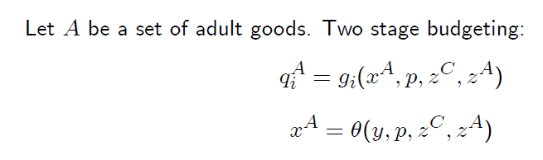
Formally
First x^{A} determined (total spending on adult goods), then the choice of adult goods (q_{i}^{A}) determined
Child characteristics (including gender)
Adult characteristics

Slide 29
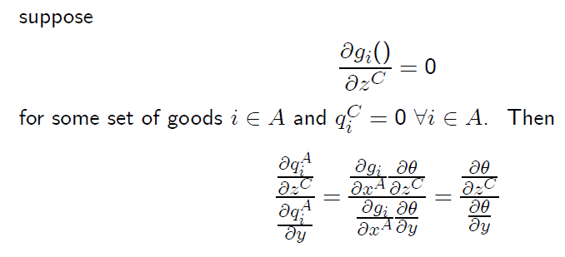
How does adult spending respond to the children?
The characteristics of child doesn’t change which adult goods bought
How spending on any adult good responds to the characteristics of a child (relative to the income effect on all adult goods) is a function just of how spending on all adult goods responds to that characteristic.
Notes:
We don’t want individual adult goods – we want adult goods as a bundle.

Slide 30
Differential spending by gender?
Intuition:
Suppose 1 more kid is associated with a reduction of, $100 in tobacco expenditure, and
1 more dollar of income is associated with an increase of $0.10 in tobacco expenditure
Then having that kid is like having $1000 less to spend on adult stuff.
Now compare these figures for girls and boys.
note: ratio of changes in spending should be the same for all goods i ∈ A, so the assumptions of the model can be tested.
Deaton found in Maharastra (huge excess female mortality) no difference in spending on adult goods by sex of child. Later repeated in Pakistan, still nothing. Why?

Slide 31
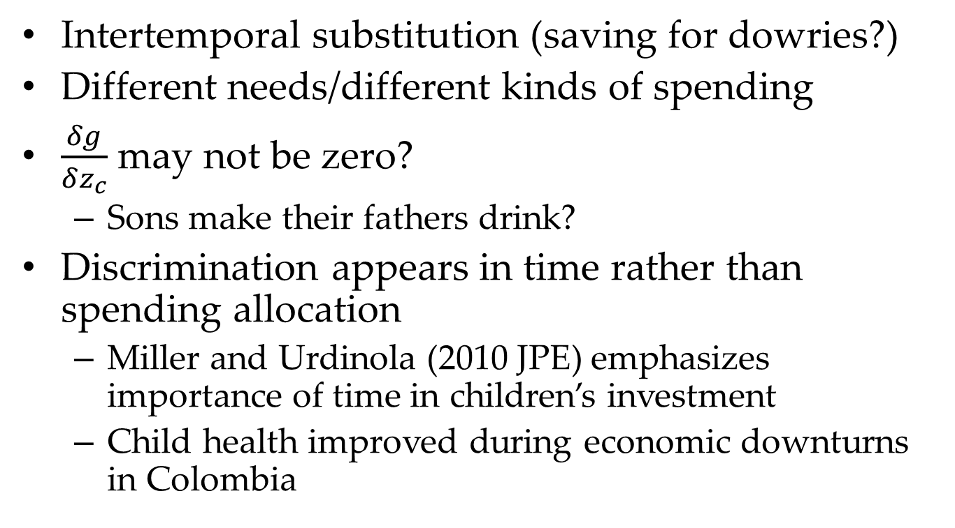
Why?
Intertemporal substitution (saving for dowries?)
Different needs/different kinds of spending
$\frac{δg}{δz_{c}}$ may not be zero?
Sons make their fathers drink?
Discrimination appears in time rather than spending allocation
Miller and Urdinola (2010 JPE) emphasizes importance of time in children’s investment
Child health improved during economic downturns in Colombia

Slide 32
Udry (1996)
Is production Pareto efficient within household?
In Burkina Faso, as in much of Africa, men and women farm their own plots
A Pareto efficient household will equalize the marginal product of inputs (e.g. fertilizer) on each plot

Slide 33
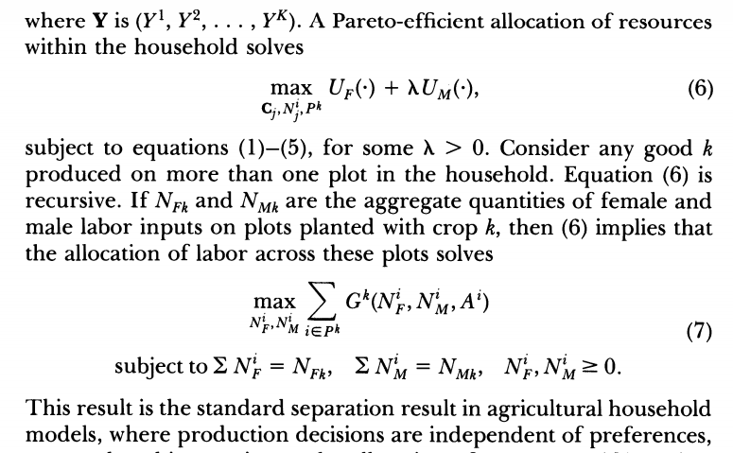
Pareto efficient production decisions
G() is a concave production function

Slide 34
Pareto efficient production decisions
Assumes no labor market (but results don’t depend on that)
Productive efficiency implies that if A^{i} = A^{j}, then
G^{k}(N^{i}_{F}, N^{i}_{M}, A^{i} )⁼ G^{k}(N^{j}_{F}, N^{j}_{M}, A^{i})
Within the household, variations across plots in output and factor inputs are functions only of variation in plot characteristics
Not who owns them

Slide 35


Testing productive efficiency
Does gender of person farming the plot matter for its yield?
Conditional on household-year-crop fixed effects
Identification concerns. Do men and women…
Have different land quality?
Detailed topographical characteristics, location, and local soil names
Farm different crops?
Look at males and females farming same crop
Notes:
Need to be sure differences in output due to differences in inputs and not diffs in unobserved plot characteristics

Slide 36
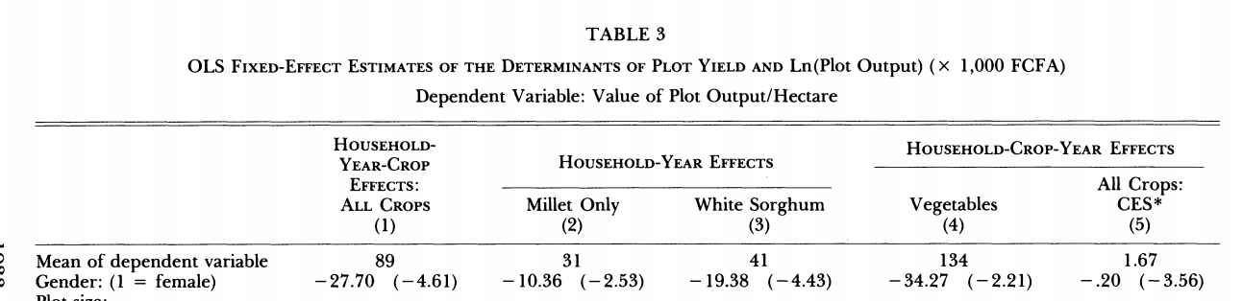
Central result
Conditional on plot size deciles, toposequence indicators, and soil type dummies
Notes:
So trying to control for within hh differences in plot quality

Slide 37
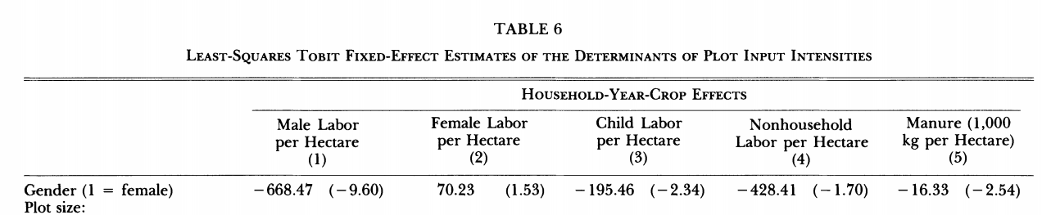
Lower input usage on female-controlled plots
Decreasing marginal product of an input → a reallocation from higher to lower user would increase total household profits
Good evidence this true for fertilizer (McIntire, Bourzat and Pingali 1993)

Slide 38
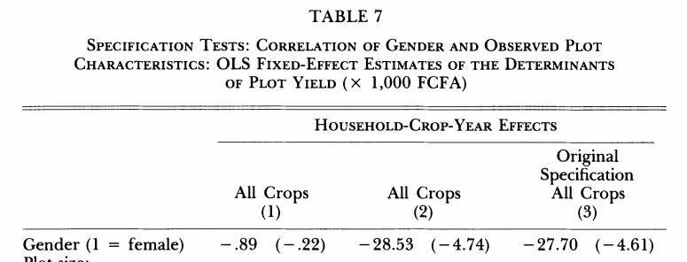
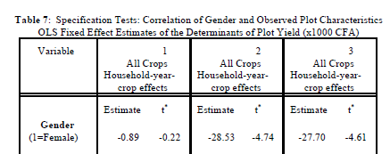
Women actually have observably higher quality plots
Dropping plot controls makes the yield gap disappear: so the gap is driven by the fact that women’s land doesn’t do as well as it should, given its observable quality
Although, given that land farmed by women allocated in the marriage market, there may be strategic reasons for offering them unobservably low quality plots

Slide 39
Other explanations consistent with efficiency
Women combine child care and labor
But more child labor on male plots, and no relationship between demographics of family and intensity of cultivation
Non-convex production sets (particularly, travel costs)
But difference persists on plots close to home
Do men and women have different managerial ability?
Estimate production functions to test for different returns to inputs
These estimates also calibrate the loss in output associated from inefficient allocation of factors
Estimate hypothetical production that would result with efficient allocation of factors; find household output could by increased by 5.89 percent
Note that intra-household misallocation still less than between household misallocation; village level output could go up by 13 percent
Notes:
So maybe women have further plots?

Slide 40
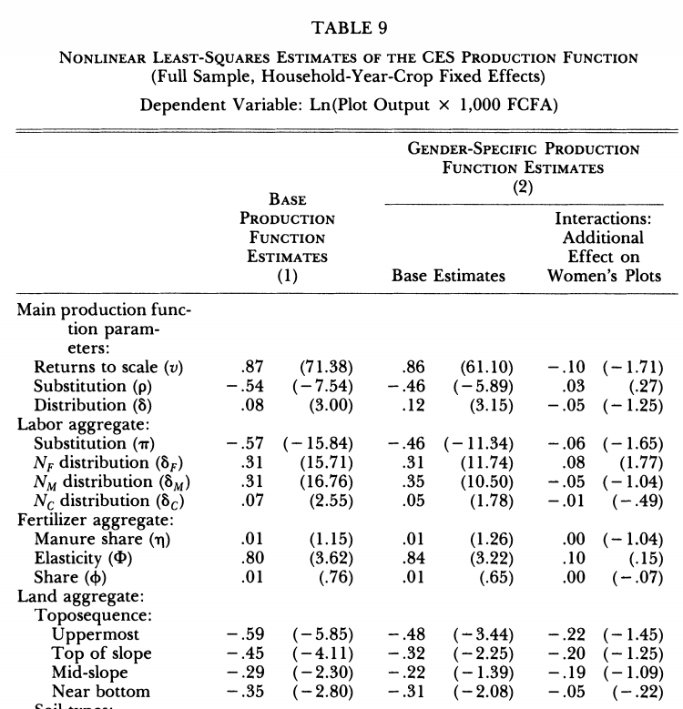
Cannot reject the null that these effects are jointly insignificant
Notes:
So it looks like men and women have same production function. Instead, it really does look like it’s an input story.

Slide 41
Udry’s interpretation of results
Land allocated to women in marriage market, as a way of letting husband commit to a certain transfer
Efficiency would be improved by offering her a financial asset instead, but this doesn’t exist
Anecdotal evidence for the kind of frictions within household that affect efficiency between households
Insecure land tenure
Transaction costs
Unitary model again rejected – and collective model too!
But! Goldstein and Udry 2008 raises the possibility that maybe the inefficiency is between rather than within household (women have less secure property rights)
Notes:
i.e. why doesn’t husband give her money and then farm all the plots efficiently

Slide 42
Noncooperative household models
Reference: Doepke and Tertilt (2014)
Key difference from collective model: each spouse makes own decision, taking other’s actions as given
Then outcomes may be inefficient (think: prisoner’s dilemma)
cf. in collective model, it’s a social planner (ensures efficiency)

Slide 43
Why do we think hh’s are inefficient?
Udry (1996) that we just saw.
See also: Duflo and Udry (2004), Robinson (2012)
HH members don’t insure each other against transitory income shocks (argue that if short run and due to luck, income shocks shouldn’t change bargaining power)
Noncooperative play in games (e.g. Hoel 2015)
Prima facie evidence: high rates of domestic violence, costly income hiding
Notes:
Assumption that

Slide 44
On the other hand…
Akresh (2008) revisits Udry (1996) in a nationally representative data from Burkina Faso
Replicates Udry’s results in areas close to ICRISAT provinces
Across the country, Pareto inefficiency more likely in bad rainfall years, especially in poor households
Bobonis (2009) and Garlick and Angelucci (2014) test Pareto efficiency on the consumption side using Progresa data
Progresa income flows to woman → exogenous variation in distribution factor (Pareto weight).
But need another one too (otherwise just estimating women’s preferences). Garlick and Angelucci use sex ratios; Bobonis uses a rainfall shock.
Do the test of Pareto efficiency we use earlier: Is the ratio of consumption changes the same for all goods?
Bobonis: cannot reject this for whole sample.
Garlick and Angelucci: reject for young but not old.
Punchline: households probably cooperative in some contexts but not others. Even within household: some evidence that the same households are efficient in consumption but not in production (Rangel and Thomas, 2012)

Slide 45
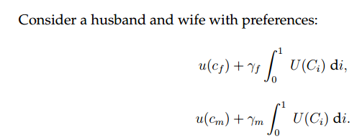
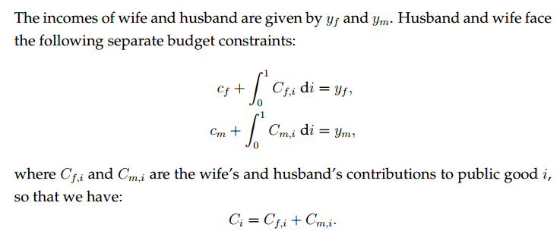
The Set-Up
(C_{i} are a continuum of public goods)
Notes:
At least some hh’s are inefficient – how can we model that

Slide 46
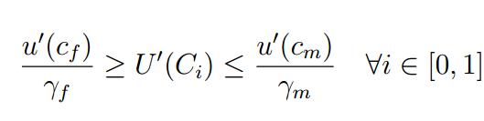
The unique Nash Equilibrium
For a given y_{m} and y_{f}…
Holds with equality if female contributes
Holds with equality if male contributes
Note that if both spouses contribute, we still have income pooling!

Slide 47
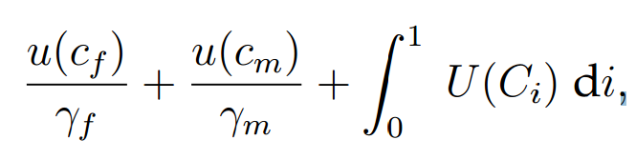
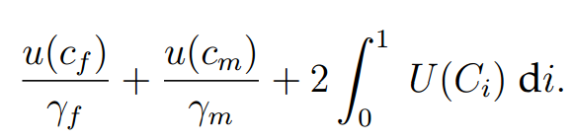
Efficiency
The FOC’s to the noncooperative problem are the same as if the planner was solving
Whereas the efficient solution would be to the problem
So public good is under-provided. Heath and Tan (2015) show that there can also be inefficiencies in production
More severe if the woman’s bargaining power is lower.

Slide 48
What would break the pooling result?
Contributions to public good are not perfect substitutes. E.g., require time.
Different spouses value different public goods (C_{i}) differently.
Sidenote: where does the differential value of the public good come from?
Exogenous (children – evolutionary basis?)
Endogenous (different opportunities for private consumption, say due to mobility/social norms)
Another active area of research: noncooperative models can’t be characterized generally like collective

Slide 49
Introducing risk and insurance models
People in developing countries face lots of income risk
Weather is the classic example. But also…
Pests, fire, output prices
Own health, etc.
And little access to formal insurance
Notes:
So not wage employment like we think of

Slide 50
Outline
Efficient risk pooling within a community
To begin with, assume away information problems (strong but not crazy? we’ll come back to this)
If hh’s can’t perfectly smooth risk between each other, individual households need to smooth risk over time
ex post (borrowing/saving)
ex ante (choice of productive activities)
Test the baseline models
Can dynamics help explain the gap between model and data? Ligon, Thomas, and Worrall (2002)

